Slide 1

Use PowerShell to Control & Automate Just About Everything!
Mike Nelson
Technical Evangelist
Pure Storage
Level: Intermediate

Slide 2
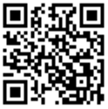
Session Survey
Your feedback is very important to us
Please take a moment to complete the session survey found in the mobile app
Use the QR code or search for “Converge360 Events” in your app store
Find this session on the Agenda tab
Click “Session Evaluation”
Thank you!

Slide 3
Agenda
PowerShell and Automation
Foundational concepts for IT using PowerShell
Accelerating & automating your code

Slide 4
How do we automate tasks as IT Admins?
Why do we use PowerShell as IT Admins?

Slide 5
3 Foundational Concepts for Using PowerShell in IT
Make my job easier
Remove human error
Focus on the good stuff

Slide 6



Simple task to full automation

Slide 7
.csv
Form
Ticket
DB
API

Slide 8
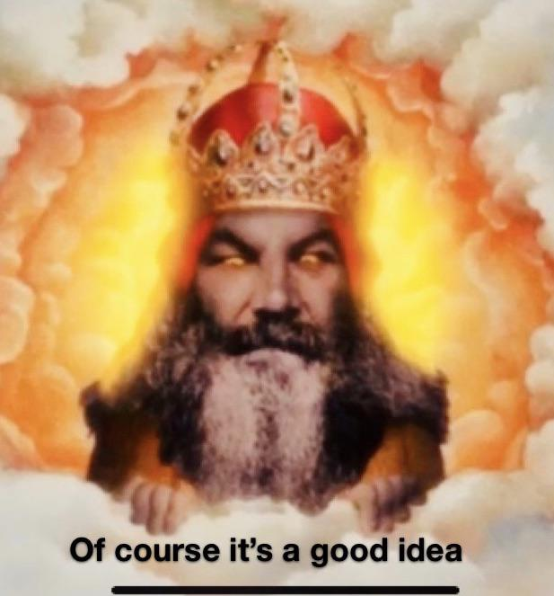
.csv
Form
Ticket
DB
API

Slide 9



Different ways to create & use automation
scripts
one-liners
functions
modules
ChatGPT
Copilot
?-AI
Web Apps
Power Automate
Vendor automate
APIs

Slide 10


Different ways to create & use automation
scripts
one-liners
functions
modules
ChatGPT
Copilot
?-AI
Web Apps
Power Automate
Vendor automate
APIs

Slide 11

Remember the 3 fundamentals.
If it takes longer than 5 minutes to do, automate it.
There are many, many ways to automate.

Slide 12
Session Survey
Your feedback is very important to us
Please take a moment to complete the session survey found in the mobile app
Use the QR code or search for “Converge360 Events” in your app store
Find this session on the Agenda tab
Click “Session Evaluation”
Thank you!

